Slide 1

Parking Management System (PMS)
T09
Roxanne Krause (Manager)
Eliud Garcia Reza
Ayman Hassen
Gabriel Ramirez

Slide 2
Objectives
Promote Efficient Parking Spot Searches
Provides real-time parking availability.
Reduces cost barriers and controls system access.
01
Consistent and Accurate Space Tracking
Updates drivers on vehicle activity in the structure.
Shows different parking spot types for informed choices.
02
03
Provide Administrative Access
Allows admins to manage the system and communicate with drivers.

Slide 3
Capabilities For The PMS
01
02
03
Real-Time Update Capabilities
Displays availability by lot and by floor.
Updates availability automatically via parking sensors (entrance + each floor).
Updates in-transit counts automatically via entry/exit sensors.
Pedestrian and Vehicle Differentiation Capabilities
Spot sensors detect vehicle type (motorcycle vs. standard).
Spot sensors distinguish vehicles from pedestrians to mark occupancy.
Entry/exit gates detect vehicles only.
Adaptable System Configuration Capabilities
Admins can configure sensors for vehicle-type detection.
Admins can customize availability displays by spot type with clear symbols.

Slide 4
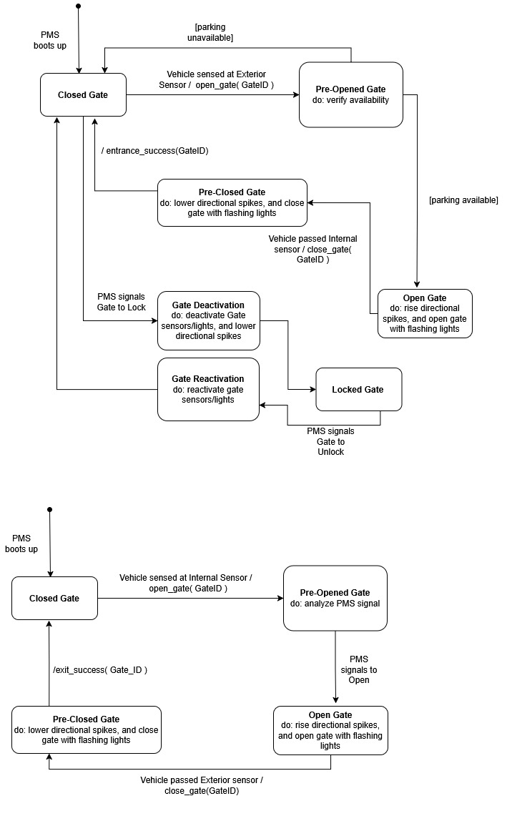
OMT Objectives with Dynamic Behavior
Entrance Gate Dynamic Diagram
Exit Gate Dynamic Diagram

Slide 5
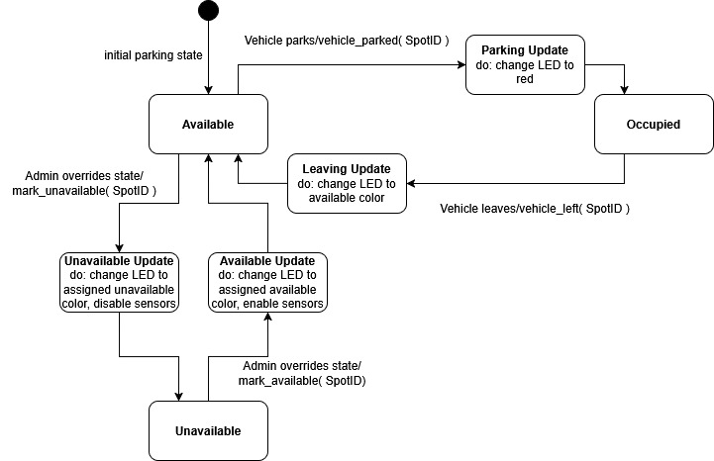
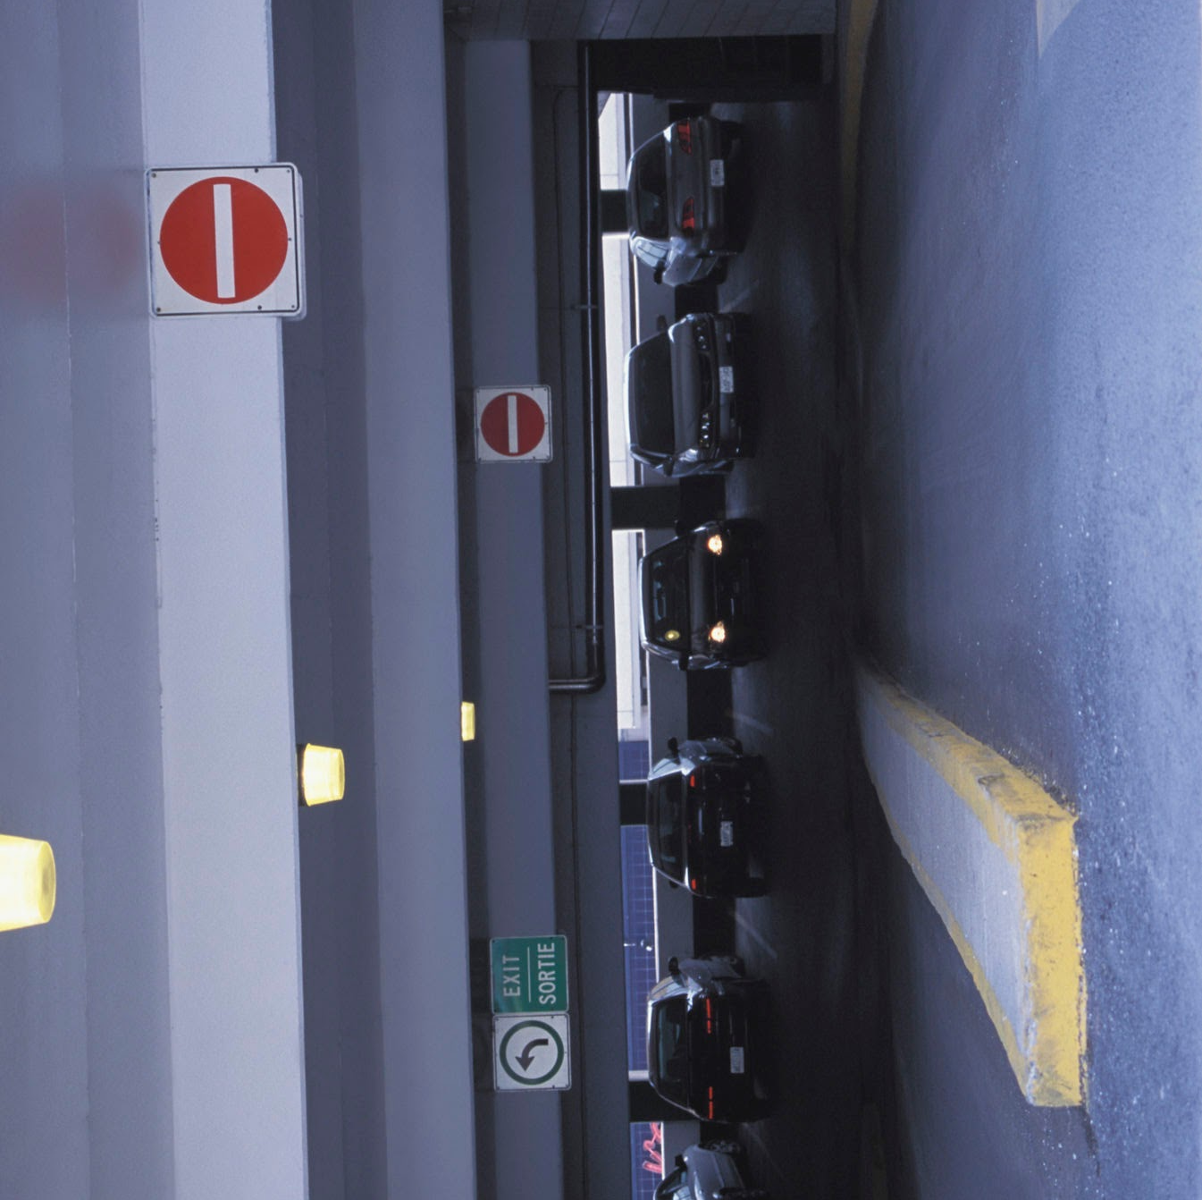

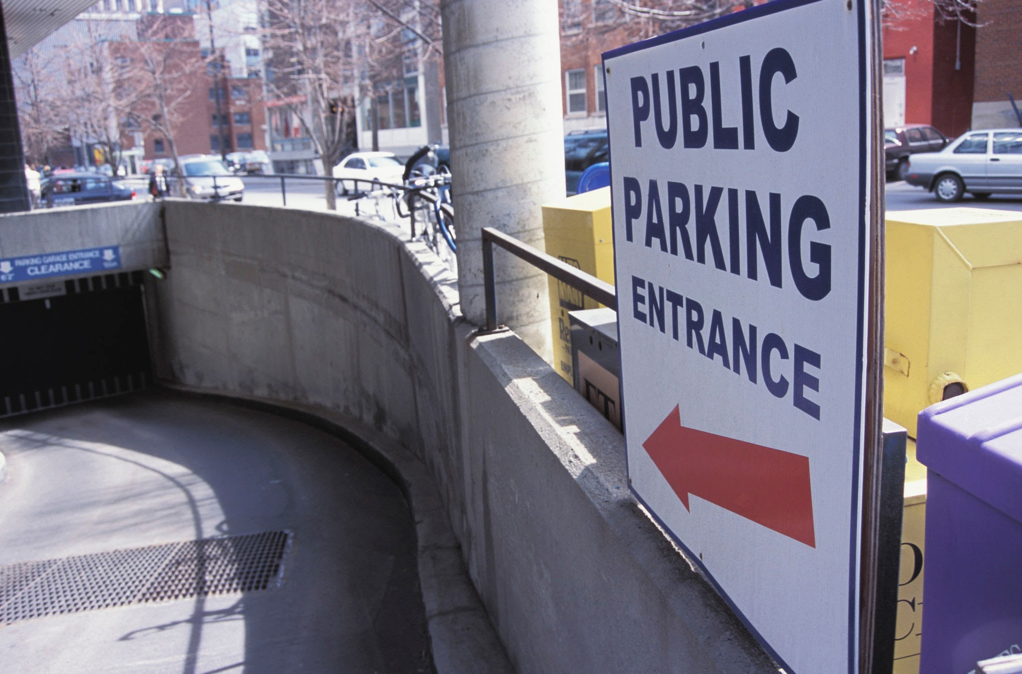

Parking Spot Dynamic Diagram

Slide 6
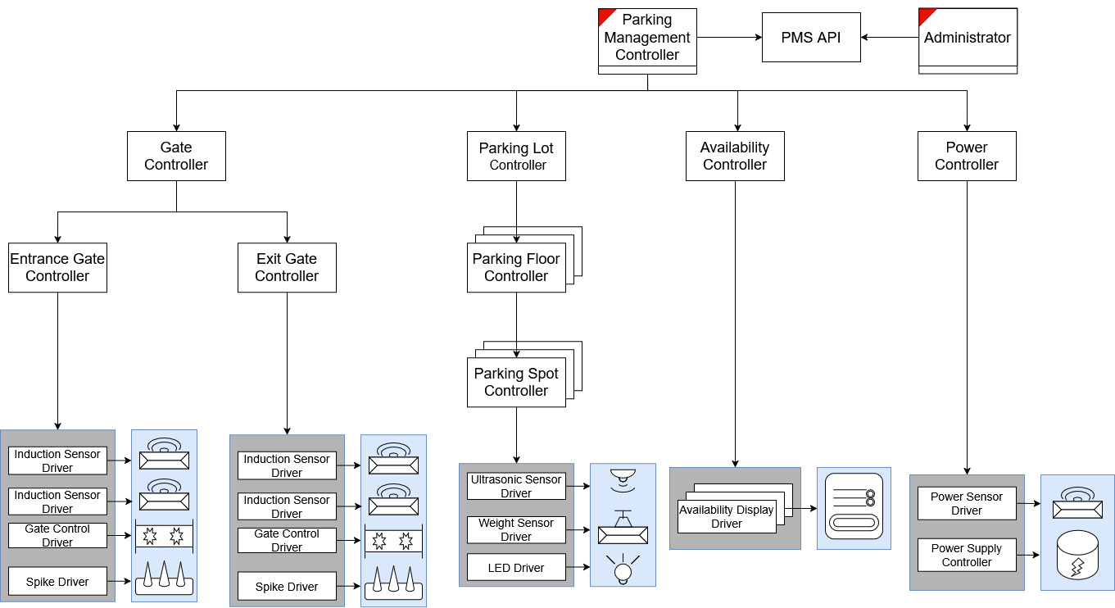
PMS Software Architecture Overview

